Slide 1
Mastering Blockchain
Decentralization

Slide 2
Overview
Blockchain 101
Decentralization
Cryptography and Technical Foundations
Bitcoin
Alternative Coins
Smart Contracts
Ethereum 101
Hyperledger
Alternative Blockchains
Blockchain-Outside of Currencies
Scalability and Other challenges

Slide 3
Contents
Introduction
Ethereum blockchain
Elements of the Ethereum blockchain
Precompiled contracts
Accounts
Block
Ether
Messages
Mining
Clients and wallets
Trading and investment
The yellow paper
The Ethereum network
Applications developed on Ethereum
Scalability and security issues
Summary

Slide 4
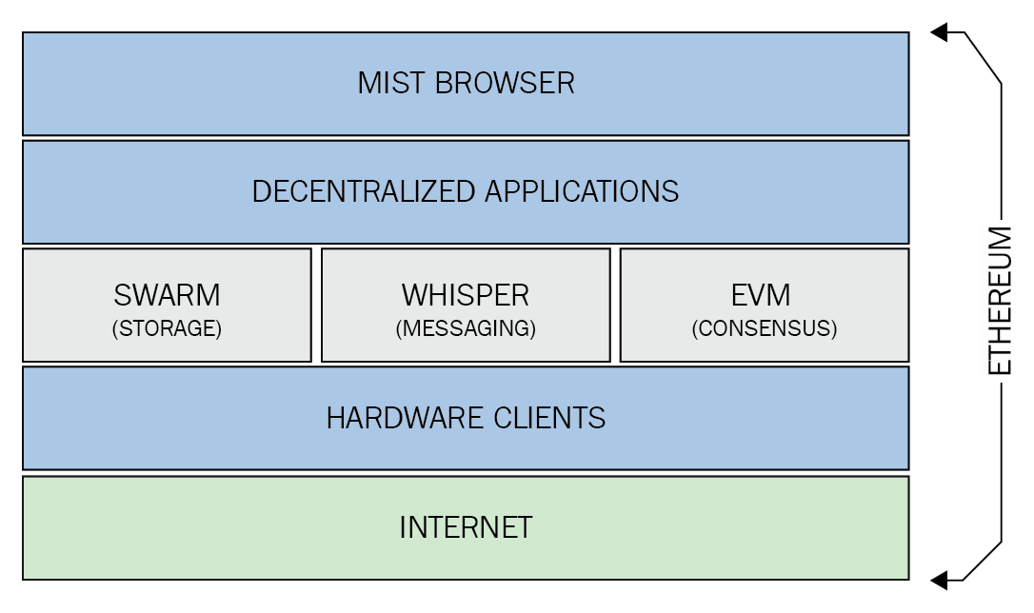
Introduction
Ethereum clients and releases
Most popular: geth and parity
The Ethereum stack
Notes:
Swarm is a peer to peer data sharing network in which files are addressed by the hash of their content. ethdocs
Whisper - Decentralized messaging A protocol for private, secure communication directly between nodes. ethdocs
EVM is a stack-based interpreter, which has a memory byte array and key-value storage. ethereum smart contract development

Slide 5
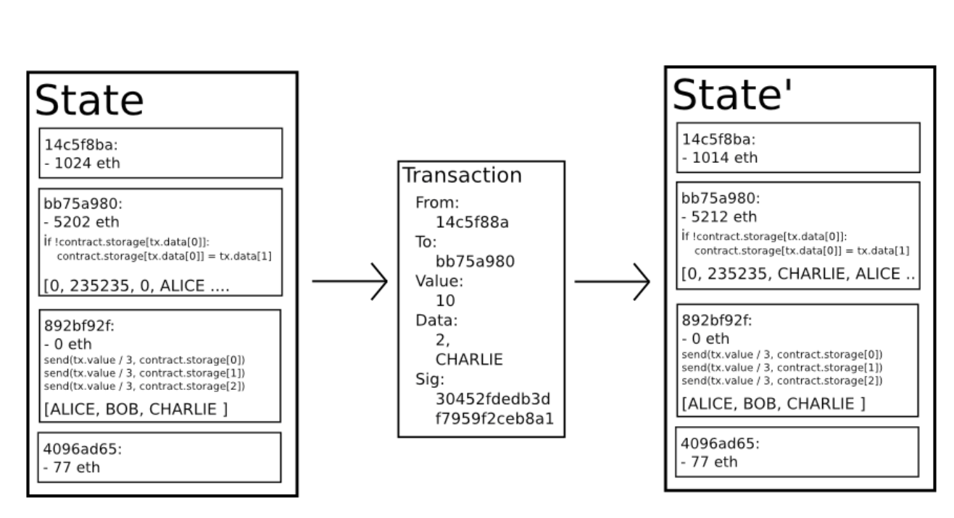
Ethereum blockchain
Notes:
State Transition Function

Slide 6
Ethereum blockchain
Currency (ETH and ETC)
Forks
Gas
The consensus mechanism: Greedy Heaviest Observed Subtree (GHOST)
The world state
Transactions
Contract creation transaction
Message call transaction
Notes:
Ethereum also rewards its native currency called Ether, abbreviated as ETH.
After the DAO hack (described later), a hard fork was proposed in order to mitigate the issue; therefore, there are now two Ethereum blockchains: one is called Ethereum classic and its currency is represented by ETC, whereas the hard-forked version is ETH, which continues to grow and on which active development is being carried out
A DAO is a Decentralized Autonomous Organization. Its goal is to codify the rules and decisionmaking apparatus of an organization, eliminating the need for documents and people in governing, creating a structure with decentralized control:
how it works:
A group of people writes the smart contracts (programs) that will run the organization
There is an initial funding period, in which people add funds to the DAO by purchasing tokens that represent ownership – this is called a crowdsale, or an initial coin offering (ICO) – to give it the resources it needs. Token give people voting rights but not ownership
When the funding period is over, the DAO begins to operate.
People then can make proposals to the DAO on how to spend the money, and the members who have bought in can vote to approve these proposals.
The very first DAO is bitcoin itself, which is governed by consensus among its core team and its mining network. All other DAOs have been launched on the ethereum platform
By Saturday, 18th June, the attacker managed to drain more than 3.6m ether into a “child DAO” that has the same structure as The DAO. The price of ether dropped from over $20 to under $13.

Slide 7
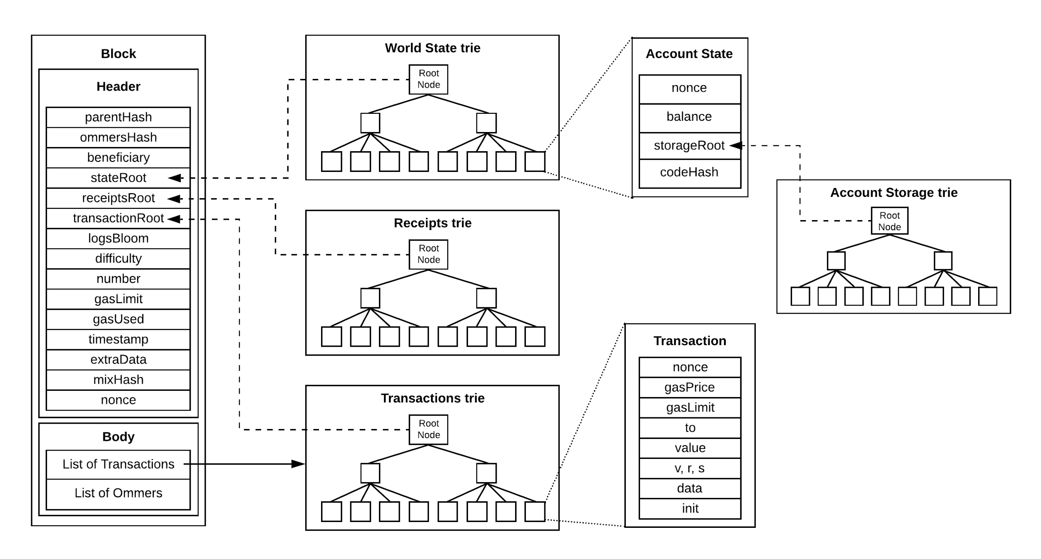
Ethereum blockchain: The world state
The account state:
Nonce
Balance
Storageroot
Codehash

Slide 8
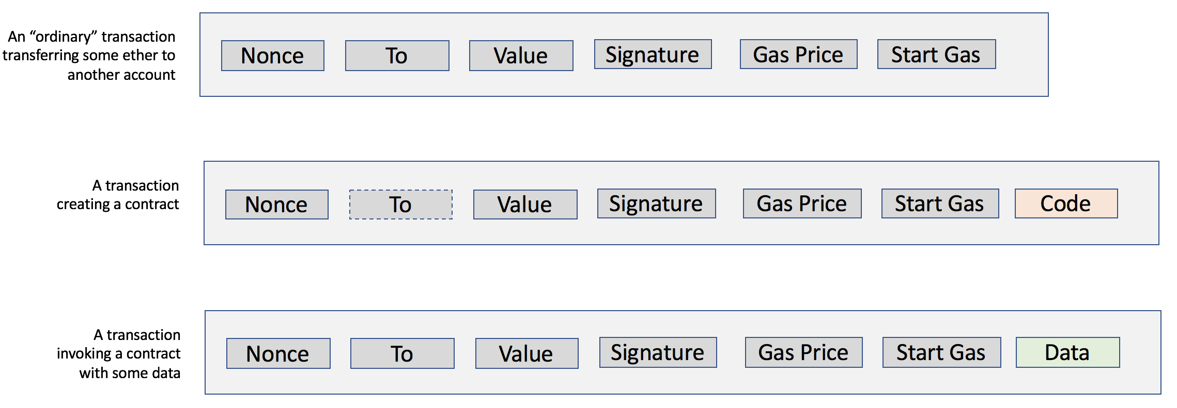
Ethereum blockchain: Transactions
Types:
Message call transactions
Contract creation transactions
Fields
Nonce
gasPrice
gasLimit
To
Value
Signature
Init
Data
Notes:
Nonce is a number that is incremented by one every time a transaction is sent by the sender
The gasPrice field represents the amount of Wei required in order to execute the transaction
The gasLimit field contains the value that represents the maximum amount of gas that can be consumed in order to execute the transaction
The to field is a value that represents the address of the recipient of the transaction
Value represents the total number of Wei to be transferred to the recipient; in the case of a contract account, this represents the balance that the contract will hold
Signature is composed of three fields, namely v, r, and s
The Init field is used only in transactions that are intended to create contracts
If the transaction is a message call, then the data field is used instead of init, which represents the input data of the message call

Slide 9
Contract creation transaction
Sender
Original transactor
Available gas
Gas price
Endowment, which is the amount of ether allocated initially
A byte array of arbitrary length
Initialization EVM code
Current depth of the message call/contract-creation stack

Slide 10
Message call transaction
Sender
The transaction originator
Recipient
The account whose code is to be executed
Available gas
Value
Gas price
Arbitrary length byte array
Input data of the call
Current depth of the message call/contract creation stack

Slide 11
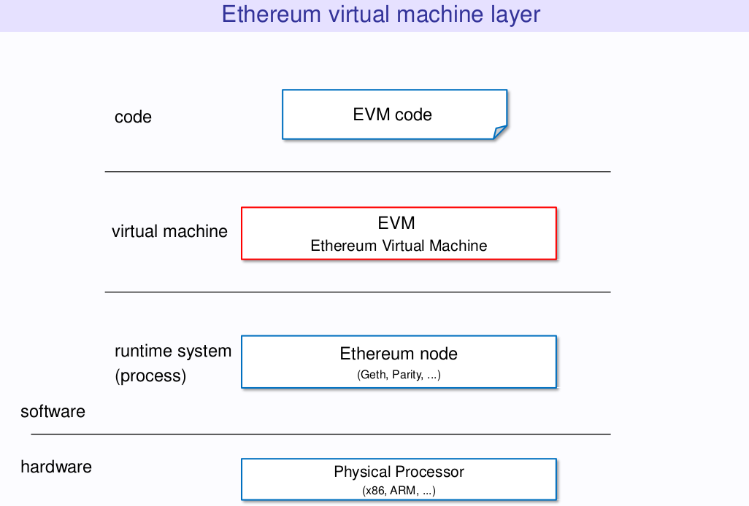
Elements of the Ethereum blockchain
Ethereum virtual machine (EVM)
Execution environment
Machine state
The iterator function
Runtime byte code
Opcodes and their meaning
Arithmetic operations
Logical operations
Cryptographic operations
Environmental information
Block Information
Stack, memory, storage and flow operations
Push operations
Duplication operations
Exchange operations
Logging operations
System operations

Slide 12
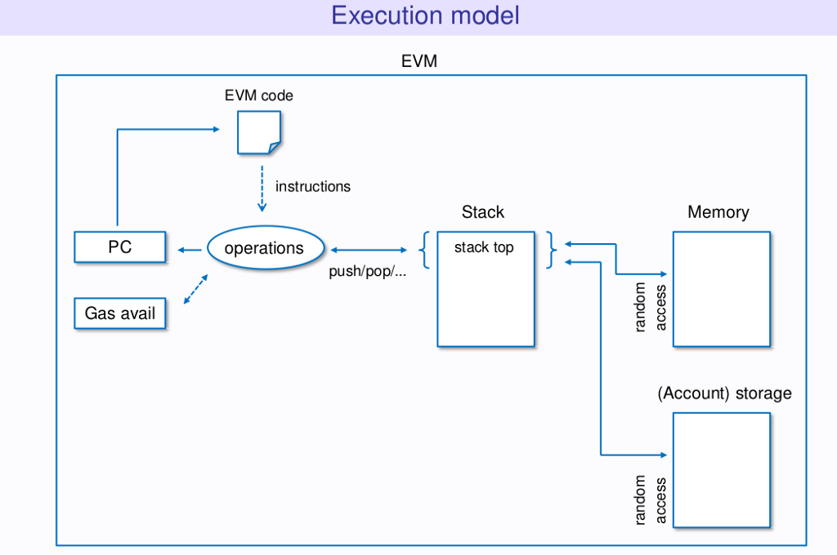
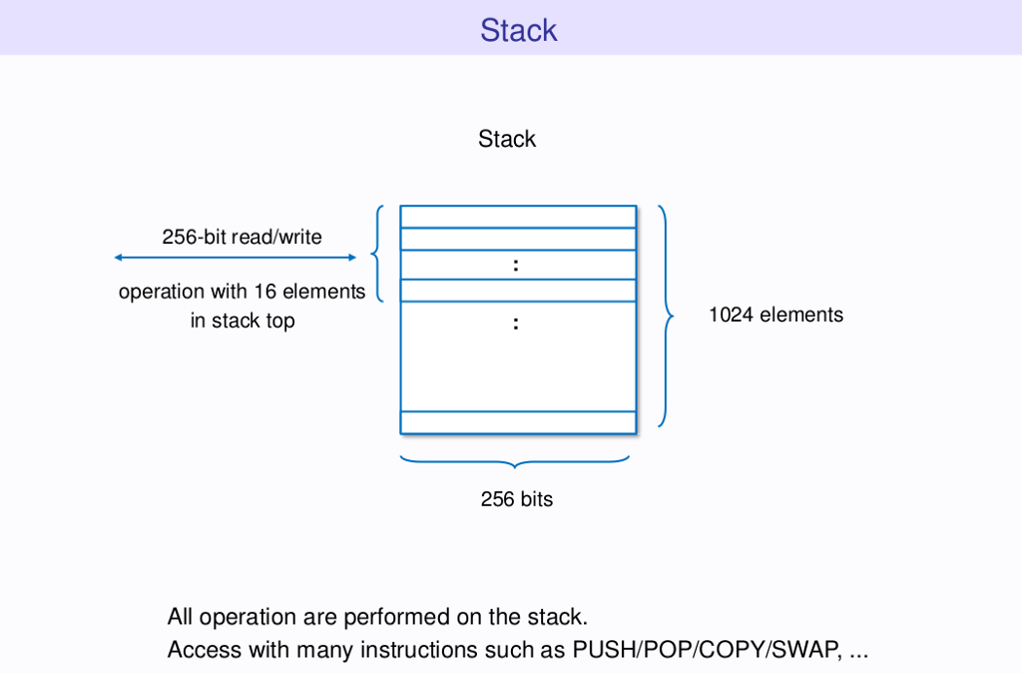
EVN operation

Slide 13
Precompiled contracts
The elliptic curve public key recovery function
The SHA-256 bit hash function
The RIPEMD-160 bit hash function
The identity function

Slide 14
Accounts
Types of accounts:
Externally owned account:
controlled by a private key
Contract accounts:
code associated with them along with the private key
ability to get triggered and execute code in response to a transaction or a message
Notes:
“EOAs are similar to accounts that are controlled by a private key in bitcoin. Contract accounts are the accounts that have code associated with them along with the private key”
“Contract Account (CA) has ether balance, associated code, and the ability to get triggered and execute code in response to a transaction or a message”

Slide 15
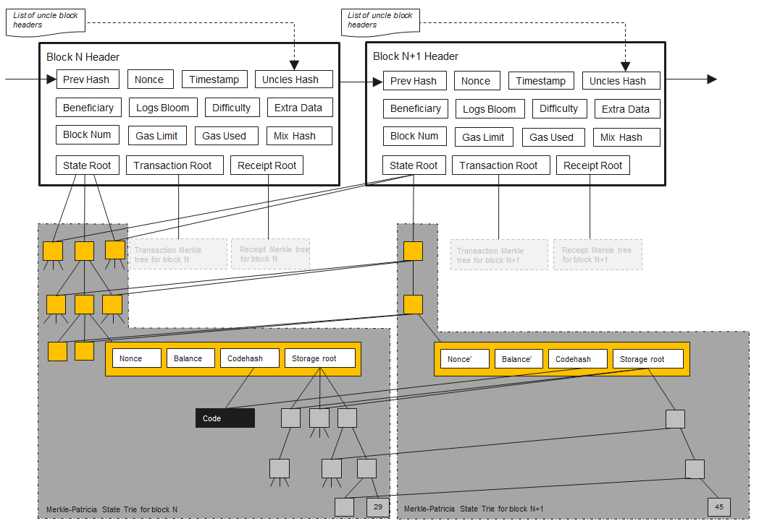
Block: Block header
Parent hash
Ommers hash
Beneficiary
State root
Transactions root
Receipts root
Logs bloom
Difficulty
Number
Gas limit
Gas used
Timestamp
Extra data
Mixhash
Nonce

Slide 16
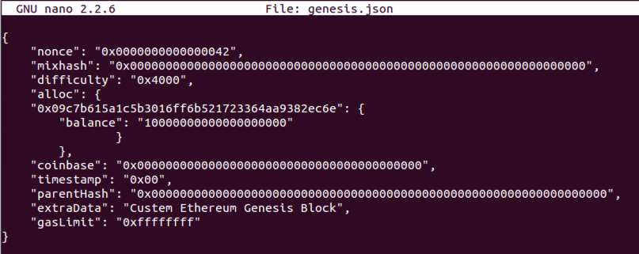
Block: The genesis block

Slide 17
Block: Transaction receipts
The post-transaction state
Gas used
Set of logs
The bloom filter

Slide 18
Block: Transaction validation and execution
The transaction sub state
Suicide set
Log series
Refund balance
Notes:
Suicide set: list of accounts that are disposed of after the transaction is executed
Log series: This is an indexed series of checkpoints that allow the monitoring and notification of contract calls to the entities external to the Ethereum environment, such as application frontends

Slide 19
Block: The block validation mechanism
Block finalization
Ommers validation
Transaction validation
Reward application
State and nonce validation
Block difficulty

Slide 20
Mining
Ethash
CPU mining
GPU mining
CPU benchmarking
GPU benchmarking
Mining rigs
Motherboard
SSD hard drive
GPU
Mining pools

Slide 21
Clients and wallets
Geth
Eth
Pyethapp
Parity
Light clients

Slide 22
The Ethereum network
MainNet
TestNet
Private net(s)
Supporting protocols
Whisper
Swarm

